Slide 1
Image similarity estimation using a Siamese Network with a contrastive loss
By
Aryan Khandelwal -21ucc027
Ekansh Khandelwal - 21ucc039
Het Patel -21ucc125

Slide 2
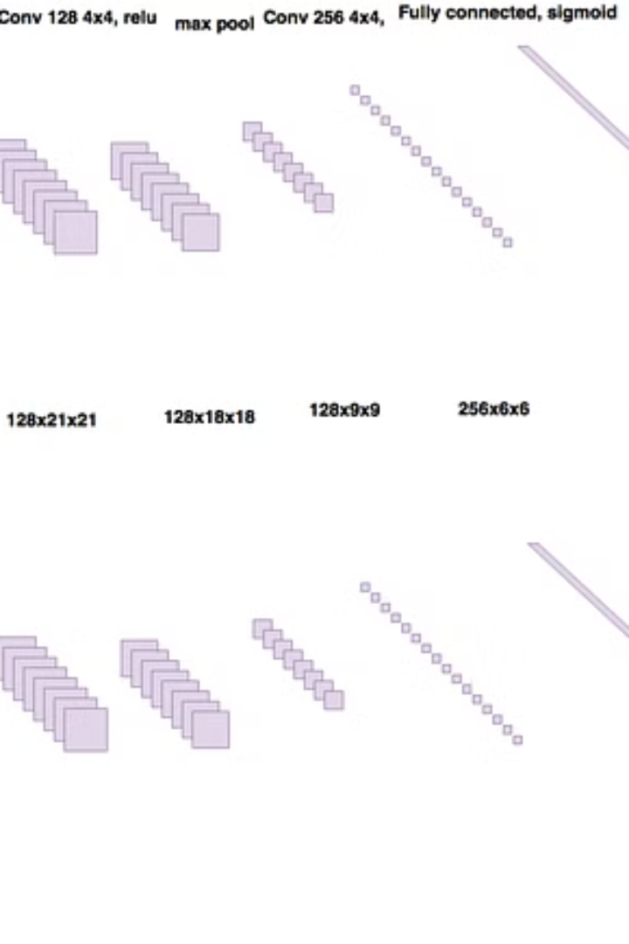
Introduction to Siamese Networks
Siamese networks are a type of neural network architecture used for tasks like image similarity, face verification, and one-shot learning. These subnetworks are fed with pairs of input data, and the objective is to learn a similarity function that can measure the similarity between the two inputs.
Notes:
These networks have gained significant attention for their unique ability to learn and understand similarity between objects or patterns in images. Let's explore what Siamese Networks are and how they revolutionize tasks like image recognition, verification, and more.

Slide 3
What is a Siamese Network?
Dual-Input Architecture
Learns Similarity
Useful for Comparison
The network learns to measure the similarity between the two input samples.
Siamese networks use two identical sub-networks to process two different inputs.
Siamese networks excel at tasks like image matching and signature verification.
Notes:
A Siamese Network is a type of neural network architecture used in machine learning, particularly in tasks involving similarity comparison. It was first introduced by Bromley et al. in 1994 for signature verification.
The hallmark of a Siamese Network is its architecture, which consists of two identical subnetworks, often called twin networks or branches. These twin networks share the same architecture and parameters, hence the term "Siamese."
Input: A Siamese Network typically takes pairs of inputs. Each input passes through both branches of the network.
Shared Weights: The weights of the neural network are shared between the twin branches. This ensures that the representations learned by both branches are compatible and comparable.
Output: The outputs of the twin branches are then compared using a similarity metric to determine the similarity or dissimilarity between the input pairs.
Learning Objective:
The primary goal of training a Siamese Network is to learn a similarity function that can measure the similarity between two inputs. This is achieved through a learning process that involves presenting pairs of inputs along with their corresponding labels (similar or dissimilar).
Training Data: The network is trained on pairs of input data, where each pair is labeled as similar or dissimilar based on some criterion relevant to the task at hand.
Loss Function: During training, the network learns to minimize the distance between similar pairs and maximize the distance between dissimilar pairs. This is typically accomplished using contrastive loss or triplet loss functions.
Applications:
Siamese Networks find applications in various domains where measuring similarity is crucial:
Face Recognition: Matching faces across different poses, lighting conditions, and facial expressions.
Signature Verification: Authenticating signatures based on their similarity to reference signatures.
Image Retrieval: Finding visually similar images in large databases.
Object Tracking: Tracking objects across frames in videos based on their appearance.

Slide 4
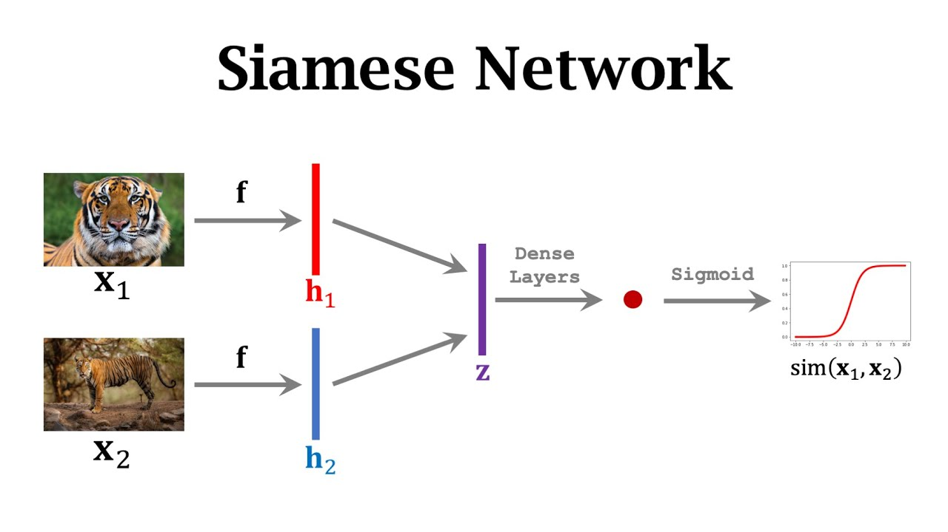
Advantages of Siamese Networks
Effective for similarity learning - Siamese networks can effectively learn the similarity between input pairs.
Robust to variations - Siamese networks can learn representations that are robust to variations in the input data.
Low data requirements - Siamese networks can learn effective representations with relatively small training datasets.
Notes:
Advantages:
Siamese Networks offer several advantages:
Robustness to Variations:
Siamese Networks are inherently robust to variations in input data. They can handle changes in viewpoint, scale, illumination, and occlusion. This robustness is particularly beneficial in tasks like face recognition, where faces may appear in different poses, lighting conditions, and facial expressions.
By learning meaningful representations of input pairs, Siamese Networks can generalize well to unseen variations, making them effective in real-world scenarios where input conditions may vary.
Few-shot Learning:
Siamese Networks require minimal labeled data for training compared to other deep learning architectures. This is because they learn to compare pairs of inputs rather than relying solely on class labels.
With just a few examples of similar and dissimilar pairs, Siamese Networks can effectively learn to distinguish between classes or categories. This makes them particularly suitable for tasks with limited labeled data, where collecting large datasets may be impractical or expensive.
Low Data Requirements:
Siamese Networks have low data requirements compared to many other deep learning architectures. This is because they learn from pairs of data points rather than relying solely on labeled datasets.
Traditional deep learning approaches often require large amounts of labeled data for training, which may be expensive or time-consuming to collect, especially for tasks where labeling is subjective or requires expert knowledge.
Siamese Networks, on the other hand, learn to understand the relationship between pairs of inputs, allowing them to perform well even with smaller datasets. This is particularly advantageous in domains where collecting large labeled datasets is challenging, such as medical imaging or rare event detection.
The ability of Siamese Networks to operate effectively with low data requirements makes them accessible and practical for a wide range of applications, especially in settings where data collection is limited or costly.

Slide 5
Contrastive Loss Function
1. A specialized loss function that trains neural networks to minimize the distance between similar inputs and maximize the distance between dissimilar inputs.
2. Encourages the network to learn meaningful representations that capture the underlying similarities and differences in the data.
The basic form of the contrastive loss function 𝐿L for a pair of inputs 𝑥1 and 𝑥2 with their corresponding labels 𝑦 is:
$$L\left(x_{1},x_{2},y\right)=\left(1−y\right)(0.5){\left(D\left(W_{x_{1}},W_{x_{2}}\right)\right)}^{2}+\left(0.5\right)\left(\max\left(0,m−D\left(W_{x_{1}},W_{x}\right)z\right)\right)$$
Notes:
Where:
𝐷(𝑊𝑥1,𝑊𝑥2)is the Euclidean distance (or any other distance metric) between the embedded representations of the inputs 𝑥1​ and 𝑥2 ​.
𝑦 is the label indicating whether the pair is similar (𝑦=1) or dissimilar (𝑦=0).
m is a margin hyperparameter that defines the minimum difference in distance required for dissimilar pairs to contribute to the loss.W represents the weights of the embedding layer.

Slide 6
Literature Review
Paper Name | Author Names | Technique Used | Advantages | Limitations
1. Siamese Neural Networks for One-shot Image Recognition | Koch, Gregory, Zemel, Richard, Salakhutdinov, Ruslan | Convolutional Neural Networks (CNN) | Few-shot learning, robust to variations | Limited to small datasets, requires careful hyperparameter tuning
2. Learning Similarity Metric Discriminatively, with Application to Face Verification | Chopra, Sumit, Hadsell, Raia, LeCun, Yann | Contrastive Loss Function | Effective in learning embeddings | Sensitive to choice of margin parameter, can be computationally expensive3
3. Deep Metric Learning using Triplet Network | Hoffer, Elad, Ailon, Nir | Triplet Loss Function | Robust to intra-class variations | Need for careful selection of triplets, sensitive to parameter settings
4. A Unified Embedding for Face Recognition and Clustering | Schroff, Florian, Kalenichenko, Dmitry, Philbin, James | Triplet Loss with Online Pair Selection | State-of-the-art performance in face recognition | Requires large-scale training data, computationally intensive inference
5. Learning a Similarity Metric Discriminatively, with Application to Face Verification | Sun, Y., Wang, X., Tang, X. | Pairwise Constrained Component Analysis | Effective in learning discriminative features | May suffer from scalability issues with large datasets, sensitive to outliers
6. Learning to Compare: Relation Network for Few-Shot Learning | Sung, Flood, Yang, Yongxin, Zhang, Li, Xiang, Philip, Hospedales, Timothy, Lu, Jun | Relation Network | Adaptability to few-shot learning scenarios | Less effective with limited annotated data, may require extensive fine-tuning
7. Matching Networks for One Shot Learning | Vinyals, Oriol, Blundell, Charles, Lillicrap, Timothy, Wierstra, Daan | Attention Mechanism | Good performance in few-shot learning tasks | Computationally expensive, sensitive to noisy data
8. Prototypical Networks for Few-shot Learning | Snell, Jake, Swersky, Kevin, Zemel, Richard | Prototypical Embedding | Simple architecture, effective in few-shot learning | Performance highly dependent on choice of metric, limited scalability
Notes:
1. Siamese Neural Networks for One-shot Image Recognition : Introduces Siamese networks for one-shot image recognition, leveraging convolutional neural networks (CNNs) for learning similarity between images.
2. Learning Similarity Metric Discriminatively, with Application to Face Verification - Proposes a method using contrastive loss function for learning embeddings, particularly effective in face verification tasks.
3. Deep Metric Learning using Triplet Network - Presents a triplet loss function-based approach for deep metric learning, robust to intra-class variations.
4. A Unified Embedding for Face Recognition and Clustering- Introduces FaceNet, which uses triplet loss with online pair selection, achieving state-of-the-art face recognition performance.
5. Learning a Similarity Metric Discriminatively, with Application to Face Verification- Utilizes pairwise constrained component analysis for learning discriminative features, especially effective in face verification.
6. Learning to Compare: Relation Network for Few-Shot Learning- Introduces relation networks for few-shot learning scenarios, offering adaptability to limited annotated data.
7. Matching Networks for One Shot Learning - Proposes matching networks with an attention mechanism, demonstrating good performance in few-shot learning tasks.
8. Prototypical Networks for Few-shot Learning- Presents prototypical embedding for few-shot learning, offering a simple yet effective architecture.

Slide 7
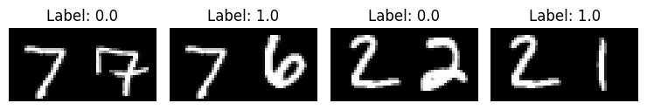
Methodology
Downloading the dataset :-
● Utilizing the Mnist dataset from keras library which contains hand-written digits.
● it contains 60,000 training images and 10,000 testing images
●we are keeping size of validation datset of size 30000.
● The data is already preprocessed .
Creation of pairs:
We will train the model to differentiate between digits of different classes.
To carry this out, we will select N random images from class A (for example , for digit `0`) and pair them with N random images from another class B(for example, for digit `1`).
we can repeat this process for all classes of digits (until digit `9`).
We will give labels to different pairs.

Slide 8
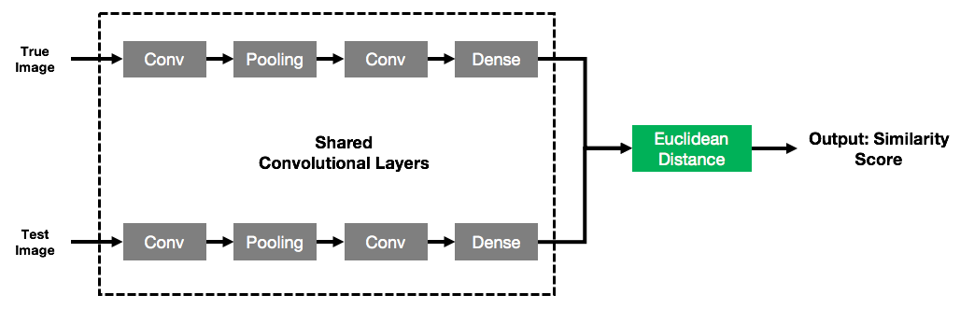
Building the Siamese network:
Defining the Network:
Model is using 2 hidden layers of 2d convolution layer with 4 filters followed by average pooling.
after convolution layers a flatten is used to convert the output into 1d.
Then Batch normalization is applied to 1d tensor and passed to a fully connected dense layer which uses tanh activation function.
Building the Siamese Network
We will be creating two similar network of the above architecture and these two networks will be share there weights.
The output of both the networks then will be utilized to calculate the Euclidian distance and then passed to a dense layer for predicting the output.
Notes:
Part 1: Defining the Embedding Network
Input Layer:
Creates an input layer for grayscale images with dimensions 28x28 pixels and a single channel.
Batch Normalization:
Normalizes the input data using batch normalization, ensuring stable and efficient training by scaling and centering the activations.
Convolutional Layer (1):
Applies a convolutional layer with 4 filters and a kernel size of 5x5 pixels.
Utilizes the hyperbolic tangent (tanh) activation function to introduce non-linearity.
Average Pooling (1):
Performs average pooling with a pool size of 2x2 pixels to downsample the feature maps.
Convolutional Layer (2):
Applies another convolutional layer with 16 filters and a kernel size of 5x5 pixels.
Again, utilizes the hyperbolic tangent (tanh) activation function.
Average Pooling (2):
Performs average pooling again with a pool size of 2x2 pixels.
Flatten:
Flattens the output of the last convolutional layer into a 1D tensor.
Batch Normalization (2):
Applies batch normalization to the flattened output.
Dense Layer:
Applies a fully connected (dense) layer with 10 units and hyperbolic tangent (tanh) activation function.
Produces the final output or embedding representation of the input image.
Model Definition:
Defines the embedding network model using the input and output layers created above.
Part 2: Building the Siamese Network
Input Layers (Tower 1 and Tower 2):
Creates input layers for the two input images (28x28 grayscale images).
Embedding Network (Tower 1 and Tower 2):
Passes the input images through the same embedding network, sharing weights between tower networks.
The embedding network produces embedding representations for both tower networks.
Merge Layer:
Computes the Euclidean distance between the embedding representations of the two towers using a custom lambda layer.
The merge layer combines the embedding representations of tower 1 and tower 2.
Batch Normalization (Merge Layer):
Applies batch normalization to the merged output to normalize the activations.
Output Layer:
Applies a dense layer with a single unit and sigmoid activation function to produce the final output.
Outputs a probability indicating the similarity between the two input images.

Slide 9

Training:
The model is trained for 15 epochs, and training/validation metrics are visualized
Contrastive loss technique is utilized for training the model which is given by :
Where,
Y =class label
Dw= Euclidean distance between outputs of sister networks

Slide 10
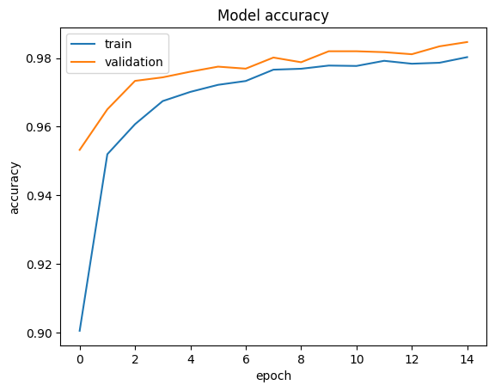
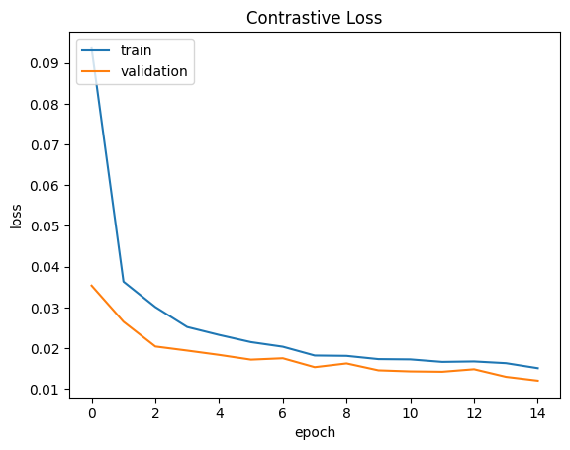
Results
● Training accuracy improves steadily over epochs, reaching approximately 98.03%.
● Validation accuracy fluctuates but demonstrates consistent improvement, achieving around 98.47%
● Visualizations of training loss, accuracy, and validation loss, accuracy are displayed:

Slide 11
Conclusion
Increasing batch size and epochs effectively improved training and validation accuracy while reducing loss.
Solely increasing epochs led to overfitting, highlighting the need for careful tuning.
Future Directions
Address issues like data requirements and training stability.
Employ early stopping to halt training when overfitting is detected
Explore data augmentation methods to diversify the training dataset.

Slide 12
References
1. J. Bromley, I. Guyon, Y. LeCun, E. Sackinger, and R. Shah. Signature verification using a Siamese time delay neural network, J. Cowan and G. Tesauro (eds) Advances in Neural Information Processing Systems, 1993.
2. Chechik, G., Sharma, V., Shalit, U., Bengio, S.: Large scale online learning of image similarity through ranking. J. Mach. Learn. Res. 11, 1109–1135 (2010)
3. S. Lawrence, C. Lee Giles, A. Chung Tsoi, and A. D. Back. Face recognition: A convolutional neural network approach. IEEE Transactions on Neural Networks, Special Issue on Neural Networks, 1997.
4. M. Lades, J. C. Vorbruggen, J. Buhmann, J. Lange, C. von der Malsburg, R. P. Wurtz, and W. Konen. Distortion-invariant object recognition in the dynamic link architecture. IEEE Trans. Computers, 42(3):300-311, 1993.
5. https://keras.io/examples/vision/siamese_contrastive/

